Slide 1
The Foreign Language Effect on Syllogistic Reasoning
Do the Conclusions Follow From the Premises?
Julia Niemczyk

Slide 2
Background
More than half of the world’s population might be bilingual!
Foreign Language Effect (FLE; Keysar et al., 2012)
Decreased susceptibility to biases in the second language
Moderated by language background
Mechanisms of the Foreign Language Effect:
Reduced emotional resonance?
Enhanced cognitive control?

Slide 3
A Foreign Language Effect on Reasoning?
Białek et al. (2020): Inverse Foreign Language Effect
Issue allocating cognitive effort in second language?
Problems with Białek et al. (2020):
Use of pseudowords
Previous experience
Language background
Participant exclusions

Slide 4

The Present Study
Conceptual replication of Białek et al. (2020) study
Addressing problems of previous research
Reasoning tested by means of syllogisms
Premise 1: All humans are vertebrates.
Premise 2: Some mammals are vertebrates.
Conclusion: Therefore, some vertebrates are mammals.

Slide 5
Methods
128 participants:
Polish-English and Spanish-English bilinguals
Between-subjects design:
Randomly allocated to solve 16 syllogisms in either first or second language.
Language Background and English Proficiency (LexTALE; Lemhöfer & Broersma, 2012).

Slide 6
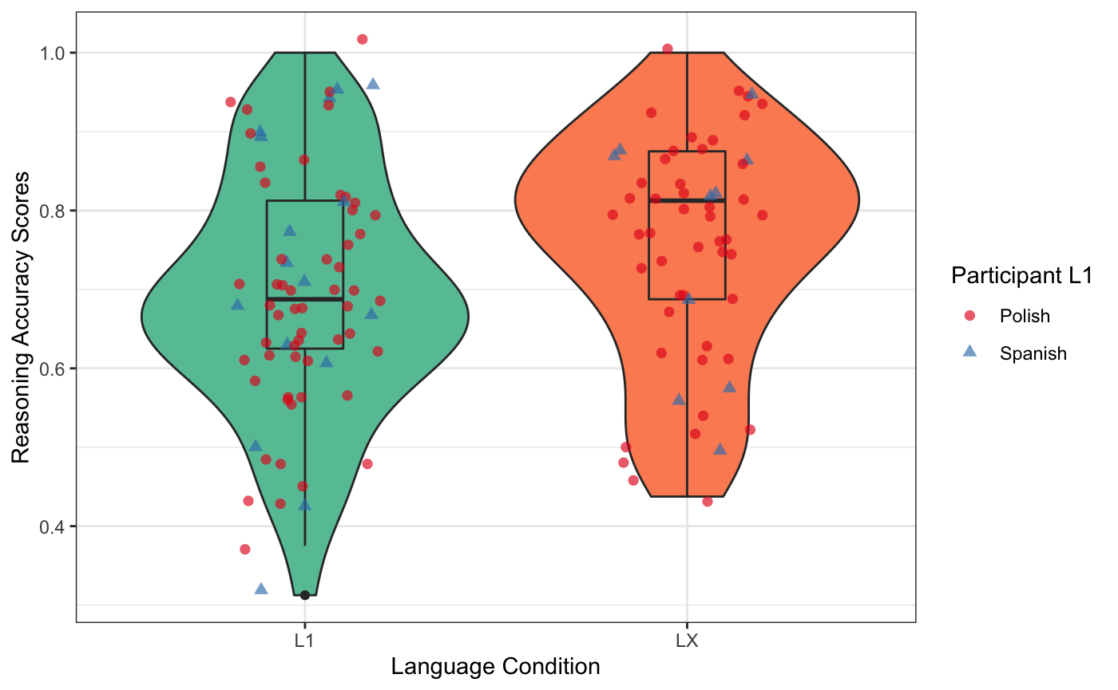
Results
Reasoning accuracy scores across language conditions and language backgrounds

Slide 7
Results
Binary logistic regression with language condition as a predictor of reasoning accuracy scores:
Completing the reasoning measure in the second rather than first language significantly positively predicted reasoning accuracy (OR = 1.34, 95% CI [1.11, 1.64], p = 0.003).
Exploratory analyses:
This effect is not exclusive to either language background.
Only proficiency moderated reasoning accuracy.
Not age of acquisition, context of acquisition, or dominant language.

Slide 8
Discussion
This study found a Foreign Language Effect on reasoning
Can sample differences explain different outcomes?
Complementarity Principle (Grosjean, 2015)
Implications for the understanding of the FLE:
Syllogisms are emotionally neutral
No explicit connection between FLE and emotions
In line with Dual Process Theories
Enhanced cognitive control is a driver of the FLE on reasoning?

Slide 9
A Way Forward
Limitations:
Incomplete grasp of language background of participants
Simplified interpretation of Dual Process Theories
Implications of this research:
Complexities of bilingual experience
Potential for debiasing interventions?

Slide 10
Questions?

Slide 11
Thank you for your attention!
Further resources:
Białek, M., Muda, R., Stewart, K., Niszczota, P., & Pieńkosz, D. (2020). Thinking in a foreign language distorts allocation of cognitive effort: Evidence from reasoning. Cognition, 205, 104420. https://doi.org/10.1016/j.cognition.2020.104420
Circi, R., Gatti, D., Russo, V., & Vecchi, T. (2021). The foreign language effect on decision-making: A meta-analysis. Psychonomic Bulletin & Review, 28(4), Article 4. https://doi.org/10.3758/s13423-020-01871-z
Keysar, B., Hayakawa, S. L., & An, S. G. (2012). The Foreign-Language Effect: Thinking in a Foreign Tongue Reduces Decision Biases. Psychological Science, 23(6), Article 6. https://doi.org/10.1177/0956797611432178

